Slide 1



Herzlich Willkommen
Welcome
Referent: Christian Neudel-Volé
EU Founder IPC
Notes:
Welcome tonight. We are so excited you joined us for the Alive Post Convention Tour.
(Introduce Yourself)
How many of you . . .
Attended our Convention in Salt Lake City last month?
Have tried the new products launched at the Convention?
Are guests or new to doTERRA in the last 6 months?

Slide 2

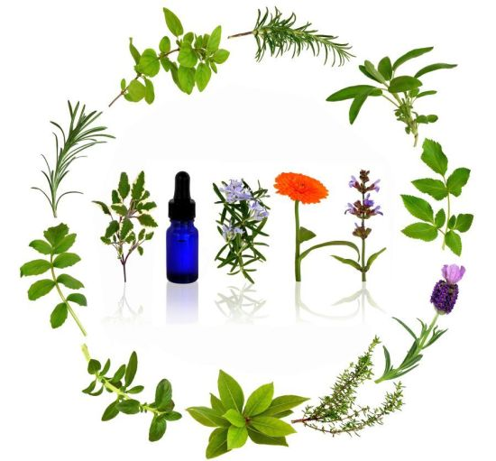
<Essential Wellness
Naturessenzen-hochfrequente ätherische Öle

Slide 3


GESUNDHEITSVORSORGE DER ZUKUNFT
Für Menschen, denen die Verbesserung Ihrer Gesundheit am Herzen liegt, bieten wir einfache, sichere und stärkende Lösungen, die das Wohlbefinden verbessern können.

Certified Pure Therapeutic Grade
© 2012 dōTERRA Holdings, LLC, Unauthorized duplication prohibited

Slide 4
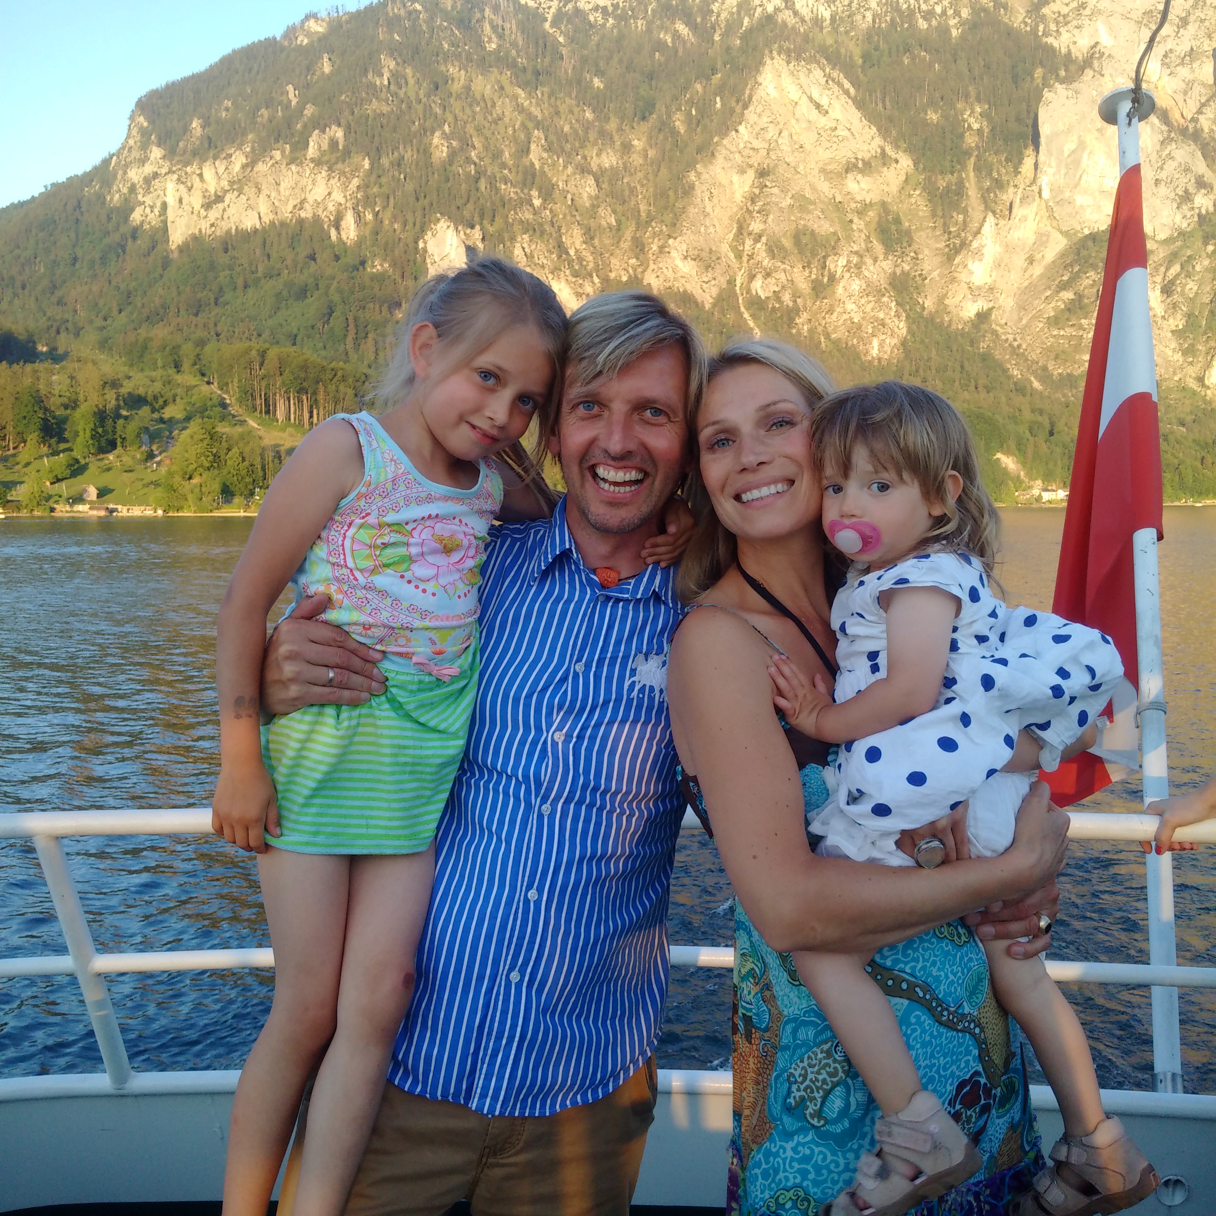
FAMILIE

Certified Pure Therapeutic Grade
© 2012 dōTERRA Holdings, LLC, Unauthorized duplication prohibited

Slide 5

VERTRAUEN

Certified Pure Therapeutic Grade
© 2012 dōTERRA Holdings, LLC, Unauthorized duplication prohibited

Slide 6
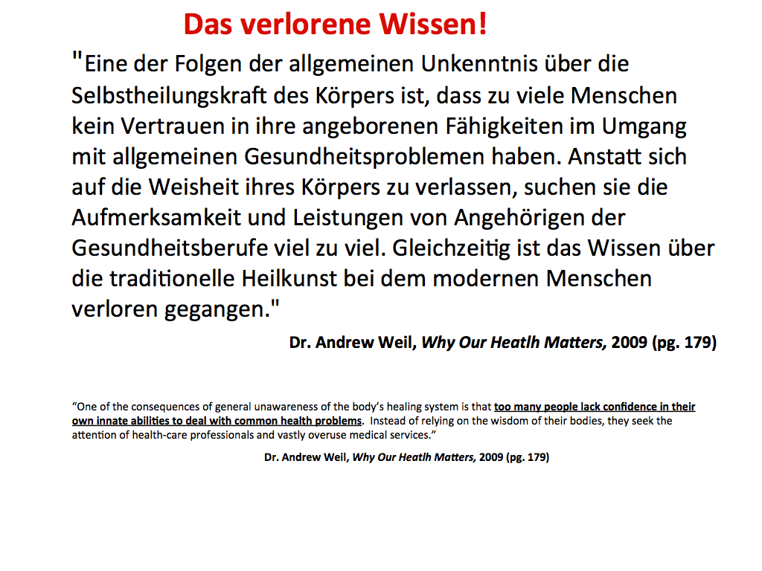
Die richtige Zeit
Die richtige Zeit / Timing
Eigenverantwortung
“Die Heilkraft des inneren Arztes erkennen“
Ein Arzt kann eine Krankheit nicht heilen. Dies kann nur unser Körper...
Certified Pure Therapeutic Grade
© 2012 dōTERRA Holdings, LLC, Unauthorized duplication prohibited

Slide 7
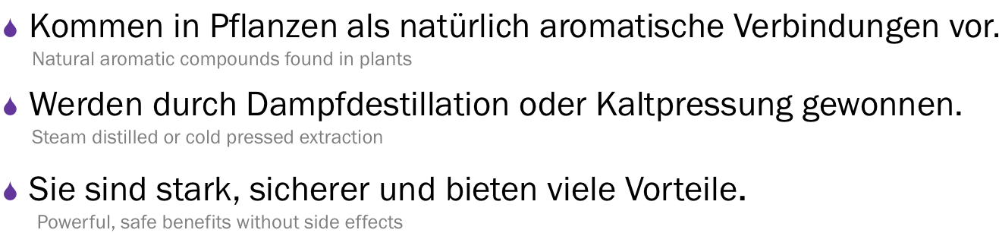
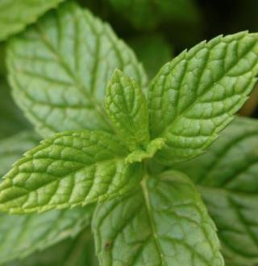
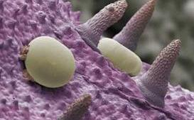
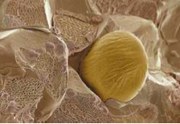
Was sind ätherische Öle?
(Öldrüsen auf einem Pfefferminzblatt / GInger

Certified Pure Therapeutic Grade
© 2012 dōTERRA Holdings, LLC, Unauthorized duplication prohibited

Slide 8
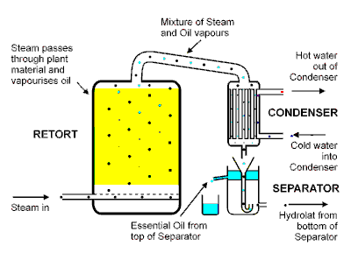
Destillation
Certified Pure Therapeutic Grade
© 2012 dōTERRA Holdings, LLC, Unauthorized duplication prohibited

Slide 9



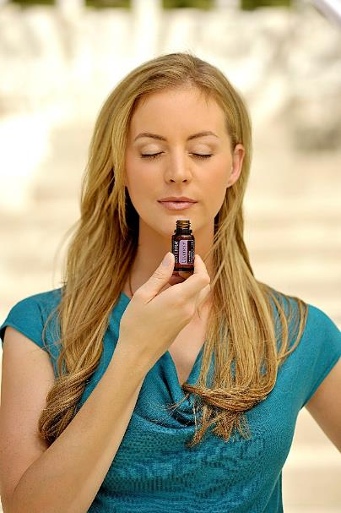
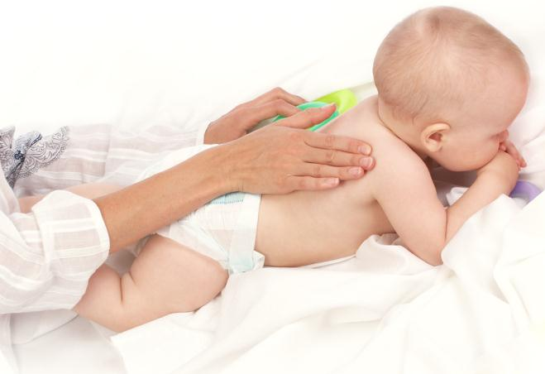


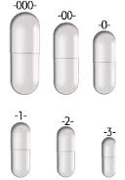
Wie kann ich ätherische Öle verwenden
AROMATISCH
Topisch-Äußerlich
INTERN
+ INHALIEREN ODER DIFUSSEN
+ ERLEICHERT MEINE ATMUNG
+ WAS ICH EINATME BEINFLUSST
MEINE STIMMUNG
+ TÖTET LUFTGETRAGENE KEIME
+ REINIGT DIE LUFT VON UNANGE-
NEHMEN GERÜCHEN
+ KRAFTVOLL- EIN TROPFEN
ÄTH. ÖL KANN JEDE ZELLE
DES KÖRPERS ERREICHEN
+ BERUHIGT SEHR RASCH
+ AUF FUßSOHLEN, HINTER DEN
OHREN,
BRUST, NACKEN, KOPF ODER
PROBLEMSTELLEN AUFTRAGEN UND
LEICHT EINMASSIEREN
+ BEI SENSITIVER HAUT MIT
FRAKT. KOKOSÖL VERDÜNNEN
+ DEM TRINKWASSER ZUFÜGEN
+ GEWÜNSCHTE TROPFEN-ZAHL
UNTER DIE ZUNGE ODER IN EINE
KAPSEL GEBEN
+ NÄHRT UND PFLEGT DEN
KÖRPER, INKL. MUND,
VERDAUUNGSSYSTEM, HALS,
LEBER UND HARNTRAKT
+ WIE AUF DEM ETIKETT
EMPFOHLEN VERWENDEN
Certified Pure Therapeutic Grade
© 2012 dōTERRA Holdings, LLC, Unauthorized duplication prohibited

Slide 10
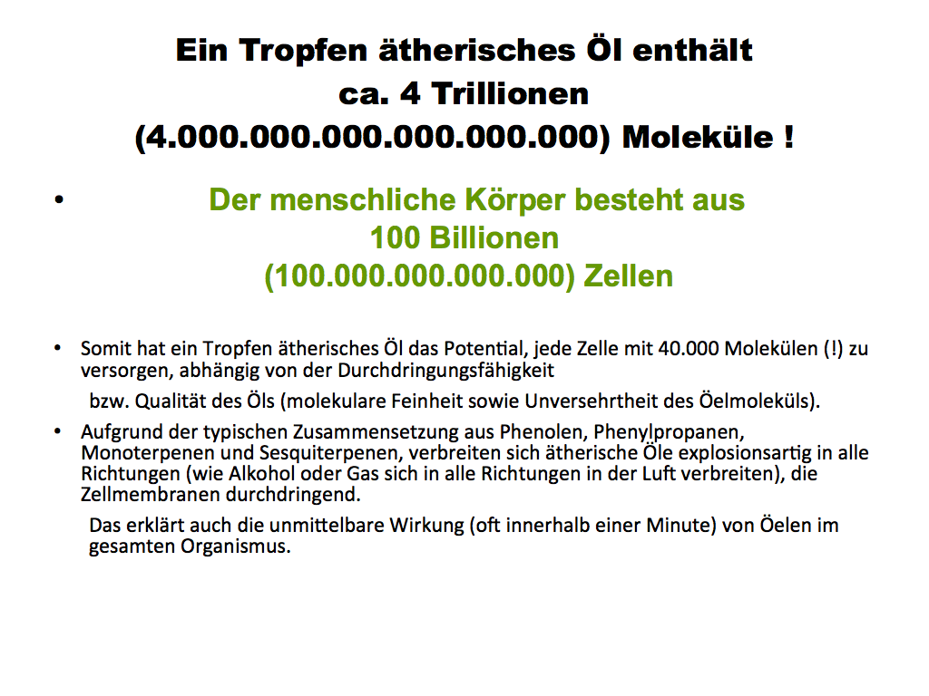
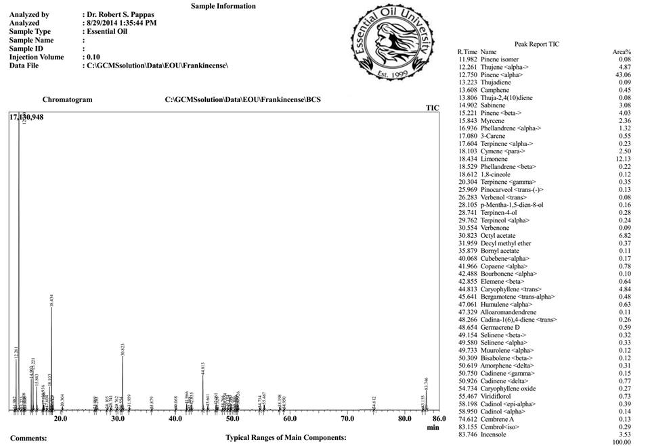
Certified Pure Therapeutic Grade
© 2012 dōTERRA Holdings, LLC, Unauthorized duplication prohibited

Slide 11
Warum dōTERRA?
Qualität und Forschung
Produkt Innovation
Sourcing (Anbau & Gewinnung)
Mission
Notes:
Many of you came tonight because you are curious about all of the new products. Some of you came because you’re not sure Essential Oils are for real.
I would like to talk about why I think doTERRA is pretty special. And how we are different in the marketplace. There are 4 main points I would like to address tonight:
Our Quality Products and the research team behind them
How we source the raw materials for our Essential Oils
I’m going to talk about all of the new and innovative products we just launched; and finally
Our mission – what we are doing to change the world.

Slide 12

Entscheidend ist die
Qualität

Certified Pure Therapeutic Grade
© 2012 dōTERRA Holdings, LLC, Unauthorized duplication prohibited

Slide 13


®
Notes:
Let me start by talking about how doTERRA Essential Oils are the highest quality available.
doTERRA uses quality control process called CPTG – which is short for Certified Pure Therapeutic Grade. This CPTG process is unparalleled in the industry. It has the most developed methodology, involves many the world’s leading experts on essential oils, and will always be on the cutting edge..
CPTG is a registered trademark of doTERRA and is used to describe doTERRA’s standard of essential oil purity and potency.

Slide 14
doTERRA ist 100% rein!!!
doTERRA ist 100% rein!!!
Die Popularität und der vermehrte
Gebrauch an ätherischen Ölen hat
eine
synthetische Marktbeherrschung
erzeugt
Certified Pure Therapeutic Grade
© 2012 dōTERRA Holdings, LLC, Unauthorized duplication prohibited

Slide 15

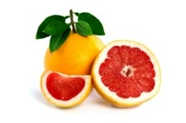

®
Rohmaterial wird geernted und destilliert
Ätherische Öle werden zu dōTERRA® geliefert
Ätherische Öle werden abgefüllt und etikettiert
Ätherische Öle werden für den Verkauf freigegeben
Primäre Bewertung
Sekundäre Bewertung
Abschließende Bewertung
Organoleptisch
Gas Chromatographie
Massenspectrometrie
Chiral GC Testung
Isotope Carbon 14
Organoleptisch
TPC/Microbiell
FTIR Scan
Schwermetalle/Pestizide
Organoleptisch
TPC/Microbiell
FTIR Scan
Stabilitätsstudien
*bei Bedarf
Certified Pure Therapeutic Grade
© 2012 dōTERRA Holdings, LLC, Unauthorized duplication prohibited
Notes:
NOTE: You can use the script below to talk about the CPTG process or you can play the CPTG Video
The CPTG testing begins immediately after distillation with each oil being reviewed for its chemical composition at a 3rd party lab. A second round of testing is carried out at our Pleasant Grove, Utah production facility to ensure that what was distilled and tested is the same essential oil as was received. A third review of the chemistry of the oil is conducted in a three-phase procedure as the oils are packaged into the bottles we use as consumers. Each of these tests confirms that the essential oil is free of contaminants and unexpected alterations during production.
The CPTG quality control protocol includes the following tests: Organoleptic, Microbial, Gas chromatography/Mass spectrometry, Fourier Transform Infrared spectroscopy (FTIR), and Chirality testing. These are big words that mean quality.

Slide 16

Dr. Brian Lawrence
PHD, Pharmacognosy
wissenschaftlicher Berater für dōTERRA
International anerkanner Experte auf dem Gebiet des Anbaus, der Verarbeitung und der analytischen Chemie ätherischer Öle.
Pionier in der Entwicklung der Technologie, auf der das ARC Diagramm, ein neues und vollständigeres Testprotokoll, basiert.
Certified Pure Therapeutic Grade
© 2012 dōTERRA Holdings, LLC, Unauthorized duplication prohibited
Notes:
When talking about the quality testing done to assure our oils are pure, safe and potent, most tests are not easy to distinguish nor to explain. Since quality tests are analytical and not visual, it makes it very difficult for the average person to understand them. That is one of the reasons why doTERRA partnered with one of our scientific advisors, Dr. Brian Lawrence, on a new and more complete testing protocol that helps to make our CPTG process more visual and complete. Dr. Lawrence is an internationally recognized expert in essential oil cultivation, processing and analytical chemistry. He pioneered the technology behind this new protocol called the ARC Plot.

Slide 17
DAS ARC Diagramm
®
Macht in einem Diagramm sichtbar:
Adulteration (Verfälschung)
Ratios and Ranges of Components
(Verhältnisse und Bereiche der Komponenten)
Composition of the essential oil
(Zusammensetzung des ätherischen Öls)
Certified Pure Therapeutic Grade
© 2012 dōTERRA Holdings, LLC, Unauthorized duplication prohibited
Notes:
Let me clarify what ARC stands for.
First, the A stands for adulteration. The ARC plots makes it possible to detect when something incorrect has been added to an oil, because it detects when there is a disruption to the natural chemistry balance found in the plant.
The “R” stands for Ratios and Ranges because is based around ratios of compounds in an essential oil and encompasses their natural ranges. To determine if an essential oil came from the original plant, we calculate multiple ratios of different compounds to each other. But this had to account for natural variation between crops and seasons, so these ratios were built into ranges.
And the “C” stands for “Composition. The ARC Plot reflects the full composition of an oil, not just parts of it.

Slide 18
®
Jedes ARC Diagramm
hat 12 Speichen
Jede Nummer reprästentiert
ein biochemisch verbundenes Paar
Jede Zahl (Speiche) hat eine
Andere Skala
Certified Pure Therapeutic Grade
© 2012 dōTERRA Holdings, LLC, Unauthorized duplication prohibited
Notes:
Here is what an ARC plot looks like. Each ARC plot has 12 spokes. We chose 12 spokes because it gave us enough room to include all the ratios necessary to distinguish an oil, but was not overly crowded or complex.

Slide 19
Oregano ARC DIAGRAMM
®
Schattierter Bereich = Optimaler Bereich für die Chemie des Oregano Öls.
Jeder Bestandteil hat ein Minimum und ein Maximum.
Wenn die Chemie nicht stimmt, wird die Probe nicht im markierten Bereich sein.
Certified Pure Therapeutic Grade
© 2012 dōTERRA Holdings, LLC, Unauthorized duplication prohibited
Notes:
Here’s an example of the ARC PLOT for Oregano. This is a visual representation of how Oregano might look. At first glance, it is somewhat star shaped with a small white area in the middle. Every oil will have its own unique shape. Over time, you may come to recognize the shape of an individual oil. If the chemistry is off, the sample won’t match!

Slide 20
Beispiele für das ARC Diagramm von OREGANO
Probe #1
Probe #2
Probe #3
Mitbewerber
®
Certified Pure Therapeutic Grade
© 2012 dōTERRA Holdings, LLC, Unauthorized duplication prohibited
Notes:
Let’s look at how individual batches of oregano essential oil look in the ARC plot. Notice in each of the samples how they fit into the shaded area? That means that it matches the fingerprint for our unique oregano oil.
Now look at a competitor sample in red. It failed because there are results that don’t fit into the shaded area. That means something was wrong with the competitor oil. Either there has been adulteration with a synthetic ingredient, poor distillation, contamination with another species, or composition that was off due to a poor harvest time.

Slide 21
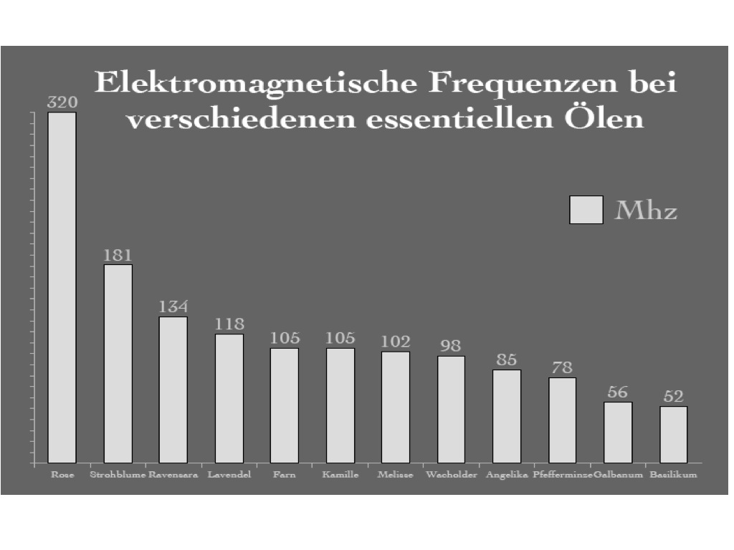
Ätherische Öle sind hochfrequent




Certified Pure Therapeutic Grade
© 2012 dōTERRA Holdings, LLC, Unauthorized duplication prohibited
Notes:
We offer singles…

Slide 22
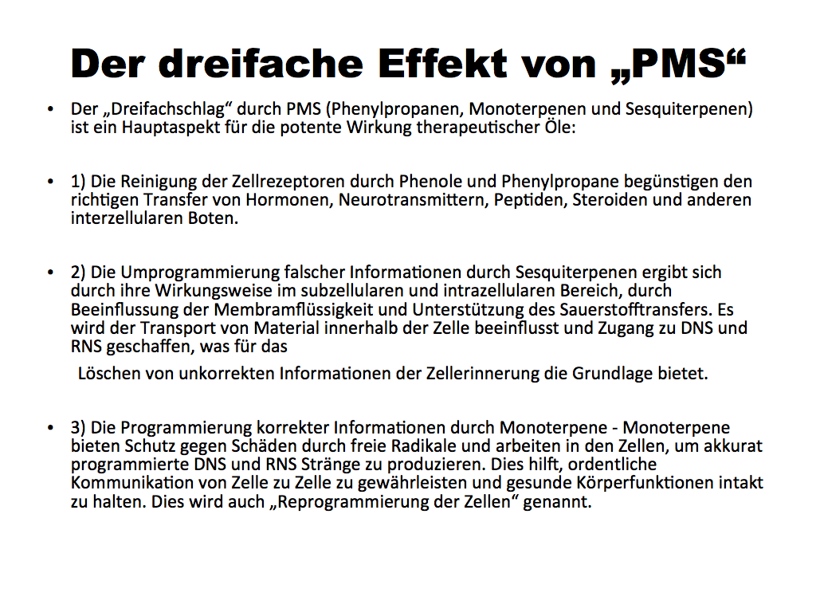


Certified Pure Therapeutic Grade
© 2012 dōTERRA Holdings, LLC, Unauthorized duplication prohibited

Slide 23

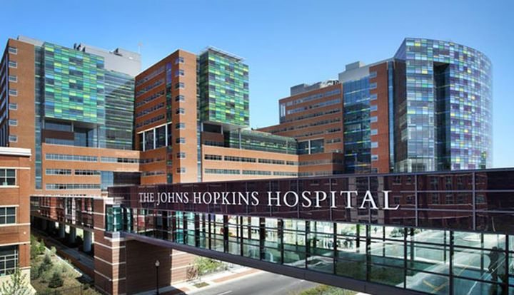
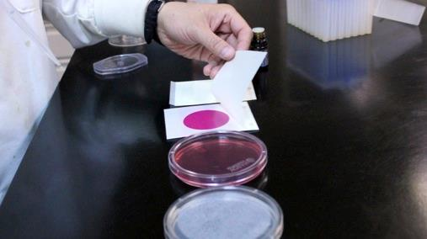
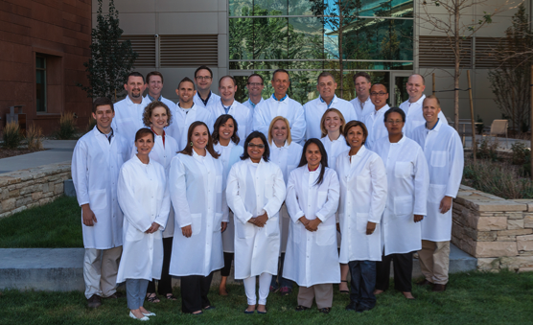
Die Kombination ist der Schlüssel
Wissenschaft & Entwicklung


Certified Pure Therapeutic Grade
© 2012 dōTERRA Holdings, LLC, Unauthorized duplication prohibited

Slide 24
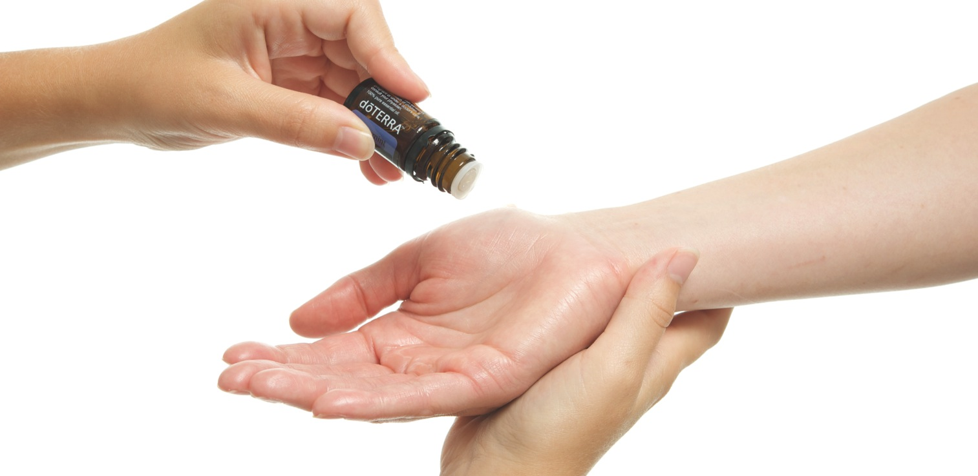
Zwei Fragen
Wie werden wir die Öle bereitstellen?
Können wir dabei auch die Welt verändern?
“Wenn ihr die Welt verändern wollt, müsst ihr Menschen stärken”
Certified Pure Therapeutic Grade
© 2012 dōTERRA Holdings, LLC, Unauthorized duplication prohibited
Notes:
There are two questions we ultimately get about the sustainability of the oils.
How are we going to supply the oils long term?
Can we change the world in the process?

Slide 25
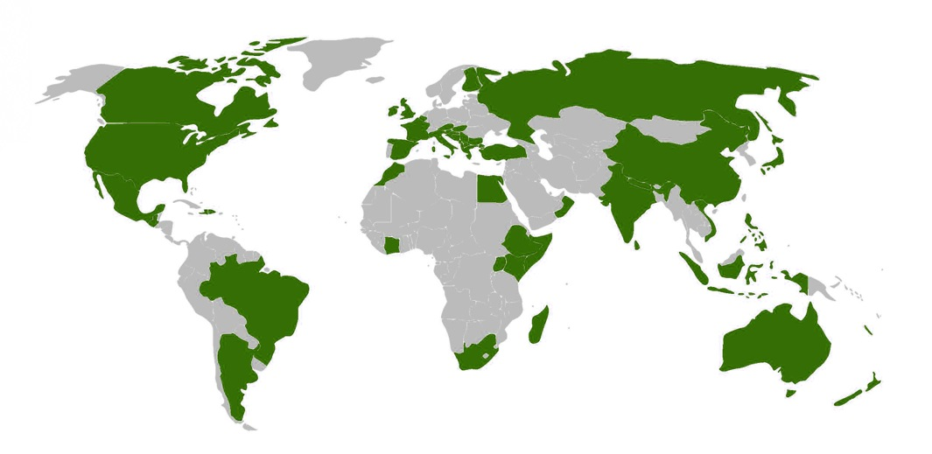
Global Oil Sourcing
40 Länder Gesamt - 23 Entwicklungsländer
Certified Pure Therapeutic Grade
© 2012 dōTERRA Holdings, LLC, Unauthorized duplication prohibited
Notes:
We source our oil from all over the world – in 40 countries to be exact. And of those 40 countries, 23 are developing countries.

Slide 26


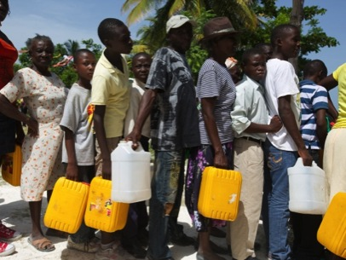

+
Entwicklung der Rohstoffkette
Verbesserung der humanitären Situation
Certified Pure Therapeutic Grade
© 2012 dōTERRA Holdings, LLC, Unauthorized duplication prohibited
Notes:
Another differentiator for doTERRA is our Co-Impact Sourcing Initiative. It combines how we source the botanicals we use to extract our essential oils from and the humanitarian relief we provide a long the way. Lets take a look at a video that explains more about this initiative.
NOTE: Show the Co-Impact Sourcing Video

Slide 27
SOURCING ZIELE:
Benötigte Menge sichern
Qualität kontrollieren
Langfristige Partnerschaften
Supply Chain Development
Certified Pure Therapeutic Grade
© 2012 dōTERRA Holdings, LLC, Unauthorized duplication prohibited
Notes:
We believe the answer to both questions is YES. First, co-impact sourcing gives us the ability to work with the growers of the botanicals we use in the production of our essential oil to ensure they can meet our supply. It also gives us the ability to train and educate them about how to best grow the botanicals in order to meet our quality standards. And last, we are able to create long term partnerships and relationships of trust. They know we will treat them well, pay them well and help their communities and economies improve.

Slide 28
GLOBAL OIL SOURCING
Certified Pure Therapeutic Grade
© 2012 dōTERRA Holdings, LLC, Unauthorized duplication prohibited
Notes:
The amount of oil we need is dramatically increasing each year. By the end of this year, we anticipate we will have used nearly 1.1 Million Kilograms of oil. But by 2017, we will be close to doubling that.

Slide 29

Humanitäre Ziele
Leiden reduzieren
Würde und Hoffnung
schenken
Teufelskreis der Armut
unterbrechen
Humanitäre Verbesserung
Certified Pure Therapeutic Grade
© 2012 dōTERRA Holdings, LLC, Unauthorized duplication prohibited
Notes:
Through our co-impact sourcing initiative, we are able to partner with our Healing Hands Foundation to help the grower communities in times of need and suffering. Ultimately, we want to help them end cycles of poverty by becoming self sufficient and give them dignity and hope for the future.

Slide 30
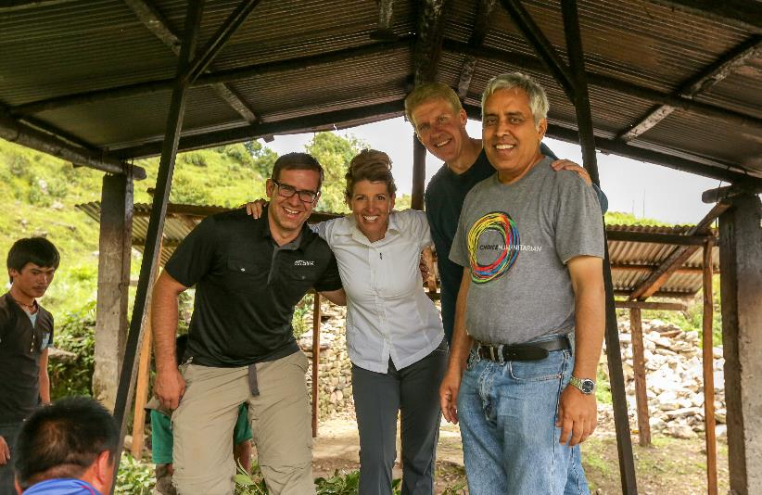
NEPAL produziert die weltweit beste Qualität …
Certified Pure Therapeutic Grade
© 2012 dōTERRA Holdings, LLC, Unauthorized duplication prohibited
Notes:
For example, we source one of our newest essential oils from Nepal. Can you guess which oil?

Slide 31
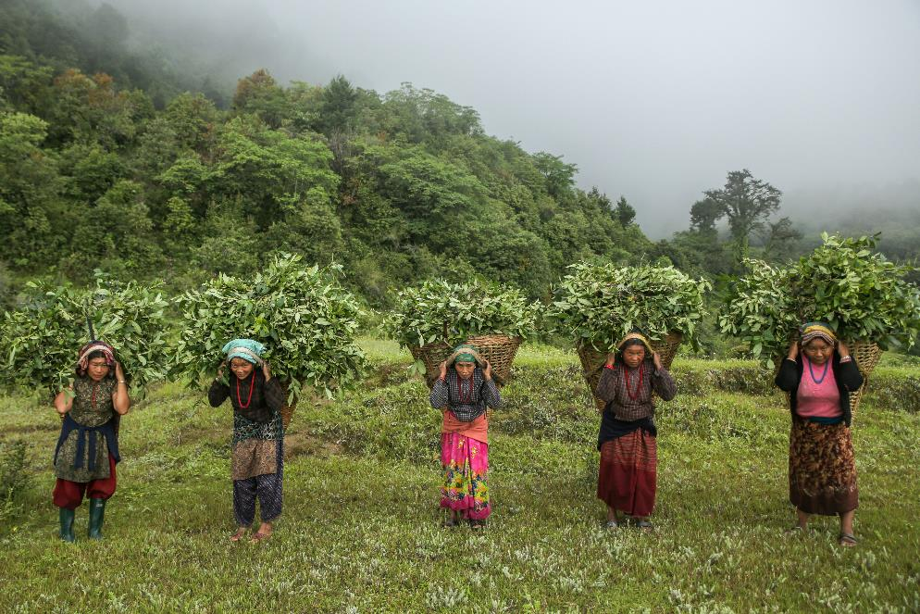
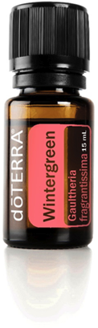
Certified Pure Therapeutic Grade
© 2012 dōTERRA Holdings, LLC, Unauthorized duplication prohibited
Notes:
If you guessed Wintergreen, you’re correct.

Slide 32

Die Medien mögen Nepal vielleicht vergessen haben…aber WIR WERDEN ES NICHT VERGESSEN!


Certified Pure Therapeutic Grade
© 2012 dōTERRA Holdings, LLC, Unauthorized duplication prohibited
Notes:
Talk about the points on the slide

Slide 33
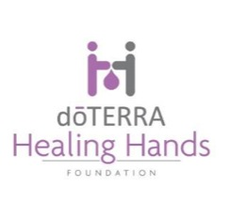
SOFORTHILFE FÜR NEPAL
35,000 kg - Reis
17,000 kg - Linsen
13,000 Planen
500 Zelte (Größe eines Klassenzimmers)
1,000 Hygiene Sets
12,000 Decken
15 provisorische Schulen
200 provisorische Häuser
Baumaterial
20 Destillationseinheiten repariert
4 neue Destillations-einheiten


Certified Pure Therapeutic Grade
© 2012 dōTERRA Holdings, LLC, Unauthorized duplication prohibited
Notes:
doTERRA and our Wellness Advocates have donated nearly $700K to help with relief efforts in Nepal.
Talk about the points on the slide

Slide 34
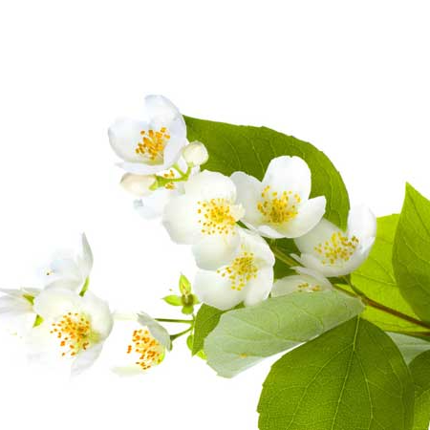
1kg reinstes Jasmin Öl kann in der Herstellung bis zu € 10.000,- pro Kilo kosten
(8Mio. gepflückte Blüten)
&
5 Tonnen Rosenblütenblätter sind notwendig, um 1 Kilo Rosenöl herzustellen
Ein Pfund synthetisches Jasmin Öl kostet in der Herstellung nur € 4.50 pro Pfund


Certified Pure Therapeutic Grade
© 2012 dōTERRA Holdings, LLC, Unauthorized duplication prohibited

Slide 35
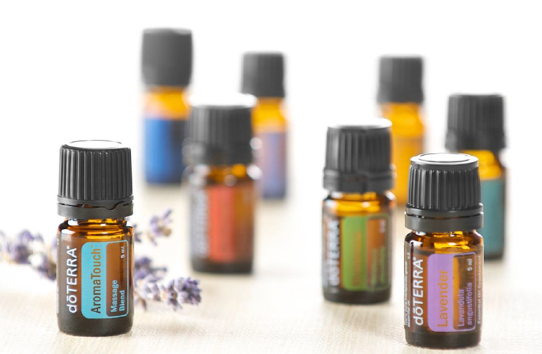
REINE ÖLE SIND SOFORT IM KÖRPER VERFÜGBAR

Certified Pure Therapeutic Grade
© 2012 dōTERRA Holdings, LLC, Unauthorized duplication prohibited

Slide 36
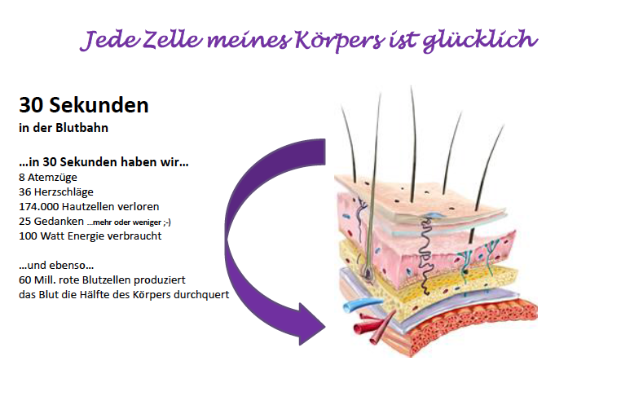

Certified Pure Therapeutic Grade
© 2012 dōTERRA Holdings, LLC, Unauthorized duplication prohibited

Slide 37
Beispiel A
Rote Blutkörperchen unter Verwendung der Dunkelfeld- Mikroskopie
Von Dr. David Hill in St. George, UT präsentiert am 25. April 2009
As presented by Dr. David Hill in St. George, UT April 25, 2009
Sie wirken SCHNELL!

Certified Pure Therapeutic Grade
© 2012 dōTERRA Holdings, LLC, Unauthorized duplication prohibited

Slide 38
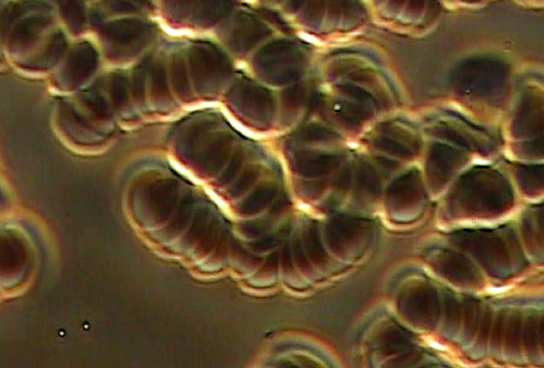
This patient’s first blood sample is not healthy.
Notes:
This patient’s first blood sample is not healthy.

Slide 39
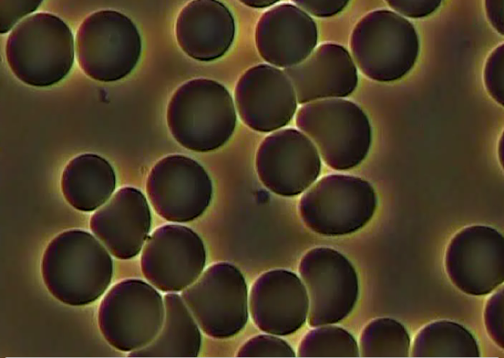
Then, they put 1 drop of a blend of essential oils called Balance, on the bottom of one of the patient’s feet and timed 30 seconds. After 30 seconds they pricked the finger to get a second blood sample, and this is what they saw.
Notes:
Then, they put 1 drop of a blend of essential oils called Balance, on the bottom of one of the patient’s feet and timed 30 seconds. After 30 seconds they pricked the finger to get a second blood sample, and this is what they saw.

Slide 40
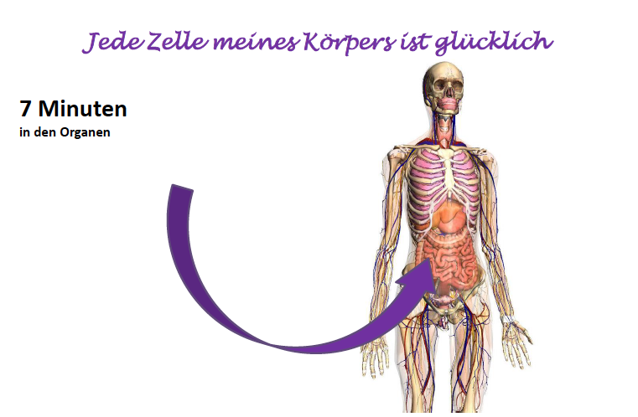

Certified Pure Therapeutic Grade
© 2012 dōTERRA Holdings, LLC, Unauthorized duplication prohibited

Slide 41
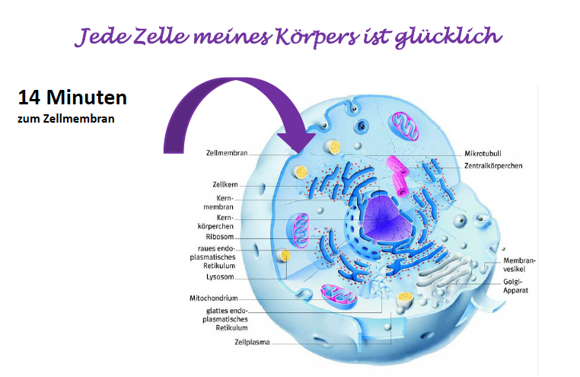


Certified Pure Therapeutic Grade
© 2012 dōTERRA Holdings, LLC, Unauthorized duplication prohibited

Slide 42
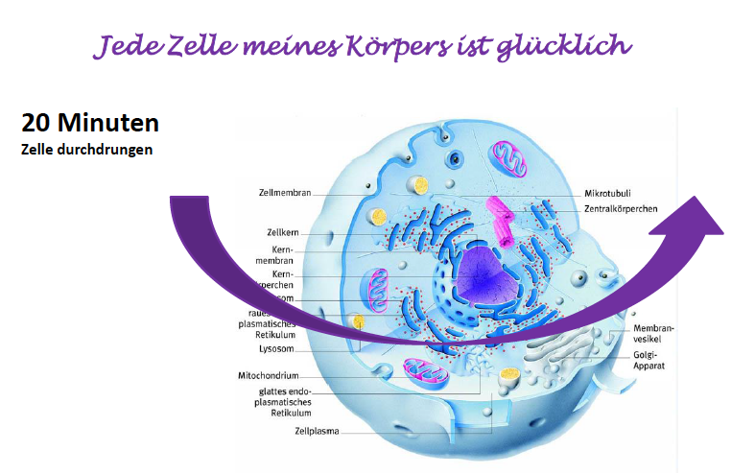

Certified Pure Therapeutic Grade
© 2012 dōTERRA Holdings, LLC, Unauthorized duplication prohibited

Slide 43
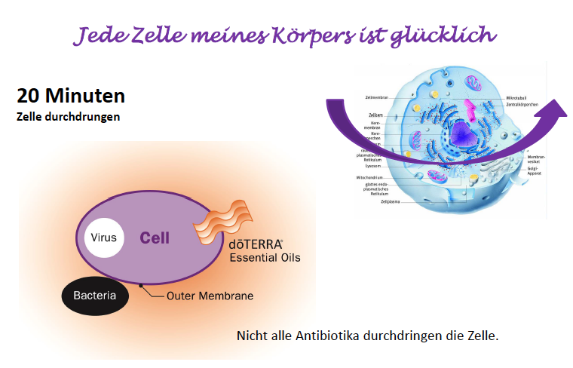

Certified Pure Therapeutic Grade
© 2012 dōTERRA Holdings, LLC, Unauthorized duplication prohibited

Slide 44
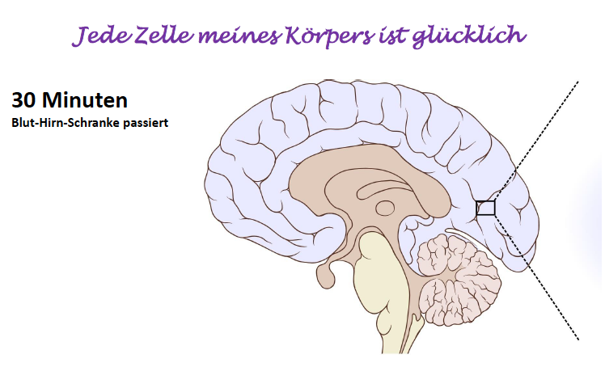


Certified Pure Therapeutic Grade
© 2012 dōTERRA Holdings, LLC, Unauthorized duplication prohibited

Slide 45
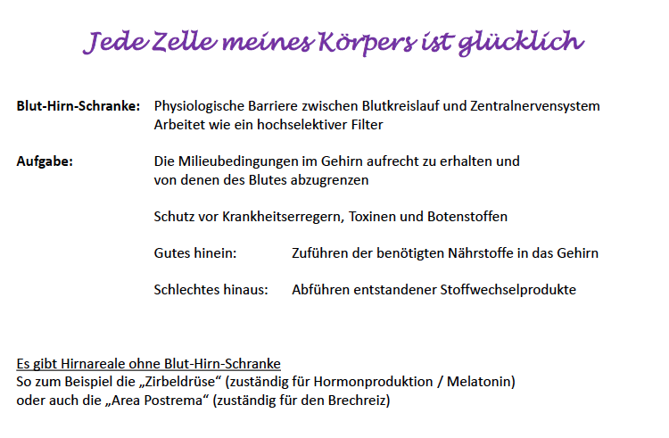

Certified Pure Therapeutic Grade
© 2012 dōTERRA Holdings, LLC, Unauthorized duplication prohibited

Slide 46
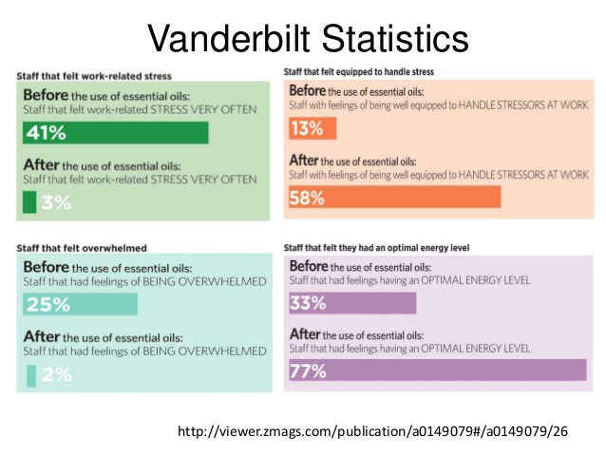

Certified Pure Therapeutic Grade
© 2012 dōTERRA Holdings, LLC, Unauthorized duplication prohibited

Slide 47

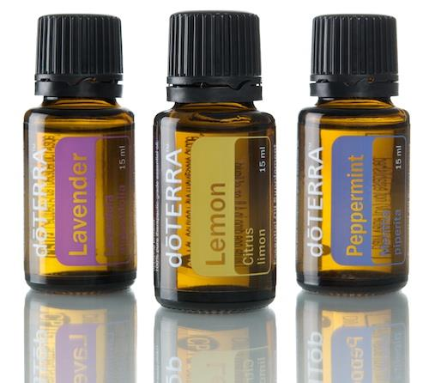
Einzigartige Wirkung mit Ölen erzielen




Certified Pure Therapeutic Grade
Certified Pure Therapeutic Grade
© 2012 dōTERRA Holdings, LLC, Unauthorized duplication prohibited
© 2012 dōTERRA Holdings, LLC, Unauthorized duplication prohibited
Notes:
We offer singles…

Slide 48
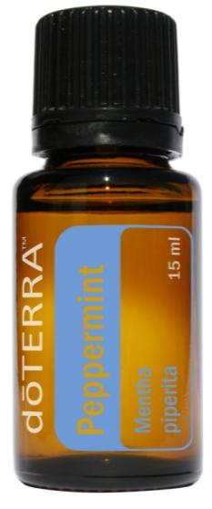
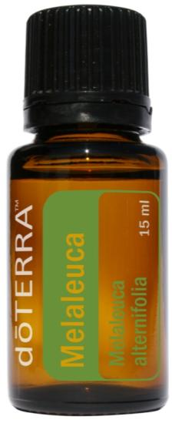
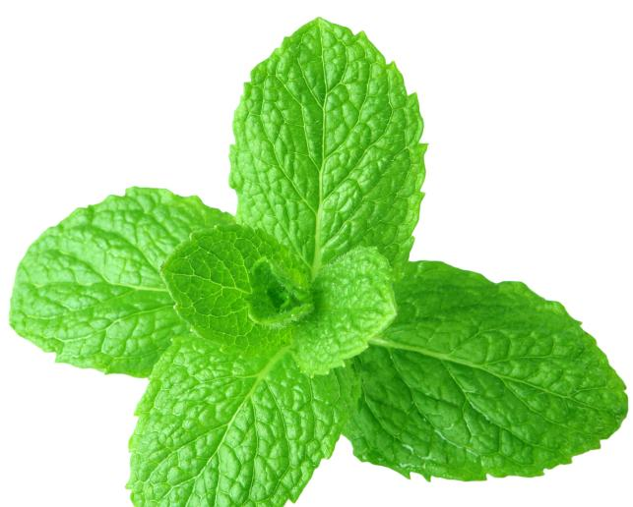
PFEFFERMINZE kühlend & belebend
TEEBAUM Erste Hilfe
Mit Zitrone und Wasser mischen für eine
gesunde, erfrischende Mundspülung
Tief einatmen um die Lungen zu stärken
und die Konzentration zu steigern
Mit Wasser in einer Sprühflasche
auf überhitzten Körper sprühen
Um Kopfschmerzen zu beruhigen mit
Lavendel auf Nacken und Stirn auftragen
Auf Hautunreinheiten oder Rötungen
auftragen für das tägliche
Reinigungsprogramm
Mit Shampoo und Conditioner verwenden
für gesunde Haare und rein Kopfhaut
Nach dem Duschen, Schwimmen oder
Training auf Fußsohlen und Zehennägel
auftragen um Fußpilz vorzubeugen

Certified Pure Therapeutic Grade
© 2012 dōTERRA Holdings, LLC, Unauthorized duplication prohibited

Slide 49
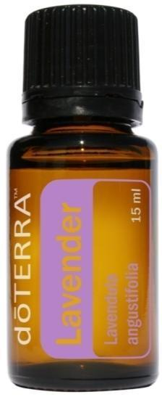
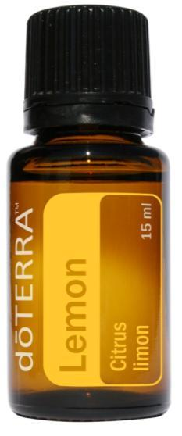

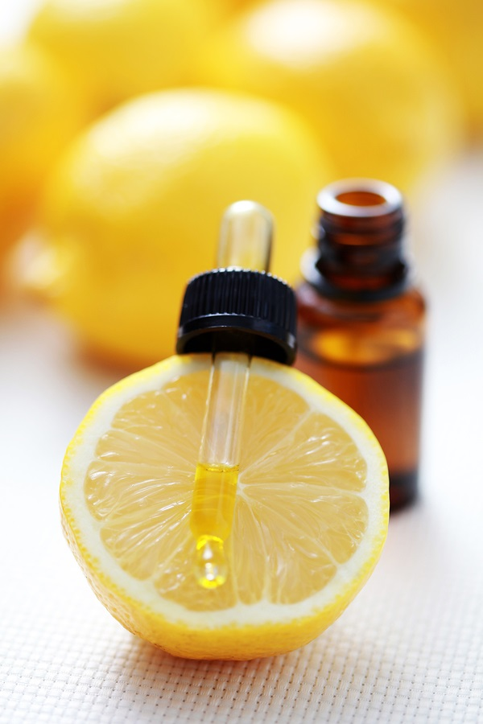
ZITRONE Reinigend und erfrischend
LAVENDEL Alles beruhigend
Mit Diffuser zerstäuben oder direkt auftragen um
Anspannung und Emotionen zu beruhigen
Direkt auftragen um irritierte Haut und Lippen zu
besänftigen
Auf Rücken oder Fußsohlen einmassieren,
einen Tropfen auf das Kissen zur Nachtruhe
Direkt auftragen um einen Bienen- oder
Insektenstich zu beruhigen
Einen Tropfen mit Honig mischen um
Halsschmerzen zu lindern
Im Raum diffusen um Gerüche zu neutralisieren
und die Stimmung zu heben
Küchenoberflächen und Edelstahlgeräte
reinigen
4-5 Tropfen jeden Morgen mit Wasser od.
Saft, um das Immunsystem aufzubauen
Als Antioxidant oder Entgiftungsmittel
mit Wasser trinken

Certified Pure Therapeutic Grade
© 2012 dōTERRA Holdings, LLC, Unauthorized duplication prohibited

Slide 50
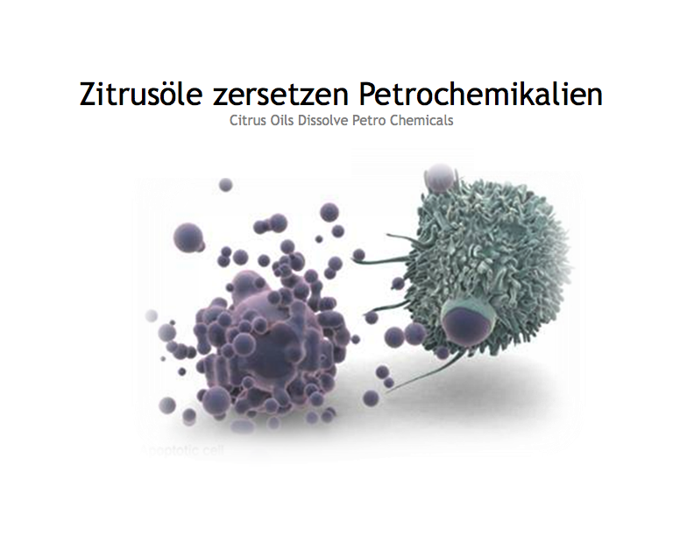

Certified Pure Therapeutic Grade
© 2012 dōTERRA Holdings, LLC, Unauthorized duplication prohibited

Slide 51
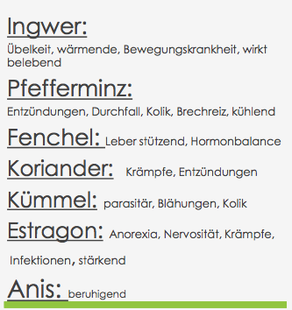
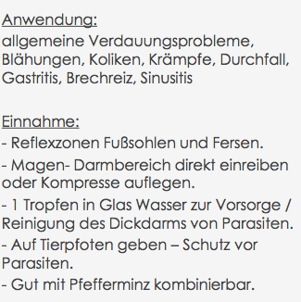
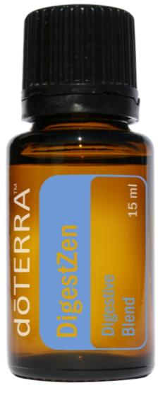
DIGESTZEN™ Verdauungsunterstützung

Certified Pure Therapeutic Grade
© 2012 dōTERRA Holdings, LLC, Unauthorized duplication prohibited

Slide 52


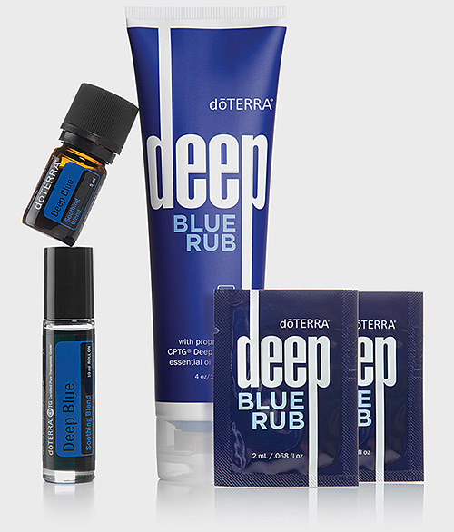

Deep Blue®
Inhaltsstoffe:
Wintergreen, Peppermint Oil, Helichrysum,
Camphor, Blue Chamomile, Blue Tansy, und
Osmanthus
dōTERRA®
Notes:
How many of you have used Deep Blue? Hands up!
Do you like it? …
For the 3 people here who have not tried deep blue, let me tell you that these products are known to be extremely potent; they really work. They provide fast relief from occasional aches and pains when used topically.
So, we thought we need to add an equally potent and fast-acting internal product to the deep blue line.

Slide 54



Deep Blue Muskelentspannung
SchmerzlinderndeBestandteile:
Wintergreen, Peppermint Oil, Camphor
Entzündungshemmende Bestandteile:
German Chamomille (blau)
Blue Tansy (marocanische Camille, blau)
Beide ätherischen Öle dienen auch zur Entspannung der Muskulatur
HeilendeBestandteile:
Helichrysum (stimmuliert den Heilungs Prozess)
Osmanthus (entspannend und Wohlgefuehl)

Certified Pure Therapeutic Grade
© 2012 dōTERRA Holdings, LLC, Unauthorized duplication prohibited

Slide 55


Welche Öle unterstützen mein Immunsystem?
Come
with Nature’s Most
Beautiful Solutions
Notes:
Thanks for coming!!! Have a wonderful evening. If you have any questions, talk to the person who brought you tonight. Or feel free to come and see myself or any of us who spoke tonight.

Slide 56




Certified Pure Therapeutic Grade
© 2012 dōTERRA Holdings, LLC, Unauthorized duplication prohibited

Slide 57

Jennifer Eddins, SM(ASCP)
On Guard® Forschung

Certified Pure Therapeutic Grade
© 2012 dōTERRA Holdings, LLC, Unauthorized duplication prohibited

Slide 58


Was ist MRSA?
Methicillin-resistant Staphylococcus aureus

Certified Pure Therapeutic Grade
© 2012 dōTERRA Holdings, LLC, Unauthorized duplication prohibited

Slide 59

Resultate
1. On Guard erweist sich
am wirksamsten im
Hemmen von MRSA
2. Steigerung der Ölmenge
erhöht nicht die Wirkung
auf den Organismus

Certified Pure Therapeutic Grade
© 2012 dōTERRA Holdings, LLC, Unauthorized duplication prohibited

Slide 60

On Guard & Schimmelpilz in der Luft

Certified Pure Therapeutic Grade
© 2012 dōTERRA Holdings, LLC, Unauthorized duplication prohibited

Slide 61



Certified Pure Therapeutic Grade
© 2012 dōTERRA Holdings, LLC, Unauthorized duplication prohibited

Slide 62



Weihrauch / Frankincense

Certified Pure Therapeutic Grade
© 2012 dōTERRA Holdings, LLC, Unauthorized duplication prohibited
Notes:
Frankincense means “true incense”. Frankincense is derived form the French word “FRANC” meaning pure or free and the Latin Incensium meaning to smoke or to kindle
Myrrh is 3 times more valuable than Frankincense, but Frankincense is 5 times more in demand (due to its scarcity).
Anciently (300 BC) over 3000 tons of Frankincense were exported from this region annually while today only a few hundred tons are produced.

Slide 63
WEIHRAUCH Historische Anwendung
In der Pharmacopeia of India von 1868 erwähnt in Verbindung mit Bronchitis, Kehlkopfentzündung, Hautprobleme (Forunkel, Geschwüre)
Historisch verwendet zur Verbesserung der Verdauung(geschluckt) und Stärkung des Zahnfleisches
Von Königinnen, Pharaohnen und Wohlhabenden in Gesichtsmasken und Kosmetika verwendet
Bis heute verwendet zur Verbesserung der Augen und als Schutz vor Infektion n

Certified Pure Therapeutic Grade
© 2012 dōTERRA Holdings, LLC, Unauthorized duplication prohibited

Slide 64


WEIHRAUCH Heutige Anwendungen
Narbengewebe, Geschwüre, Wunden
Depression
Gesunde Immunreaktion
Analgetikum
Entzündungshemmend Nervosität
Hautpflege, Falten
Kehlkopfentzündung
Gebärmutter-Störungen, Tumor
Kopfschmerzen, Migräne
Alzheimer-Demenz

Certified Pure Therapeutic Grade
© 2012 dōTERRA Holdings, LLC, Unauthorized duplication prohibited
Notes:
Discuss all of the research regarding frankincense and its value as a daily use oil

Slide 65

Verbrennung 3.Grades mit kochendem Wasser

Slide 66

5 Tage später nach täglichem Auftragen von Lavendel und Teebaum
5 Days After Applying Lavender and Melaleuca Daily

Slide 67


5 Tage später nach täglichem Auftragen von Lavendel und Teebaum, Weihrauch+ FCO

Certified Pure Therapeutic Grade
© 2012 dōTERRA Holdings, LLC, Unauthorized duplication prohibited

Slide 68

14 Tage Zeitraum nach mehrmals täglichem Auftragen von jeweils 1-2 Tropfen Weihrauch, Geranium & Teebaum

Certified Pure Therapeutic Grade
© 2012 dōTERRA Holdings, LLC, Unauthorized duplication prohibited

Slide 69


Certified Pure Therapeutic Grade
© 2012 dōTERRA Holdings, LLC, Unauthorized duplication prohibited

Slide 70




Innovative Produkte
Ätherische Öle
Einzelöle
Ölmischungen
Produkte, die Öle enthalten
Wellness
Nahrungs-ergänzungen
Gezielte Vorteile
Spa
Hautpflege Produkte
Haarpflege
Living
Haushalts-reiniger
Körperpflege
Waschmittel

Certified Pure Therapeutic Grade
© 2012 dōTERRA Holdings, LLC, Unauthorized duplication prohibited
Notes:
At the heart, doTERRA is an Essential Oil Company. But what is most impressive is how doTERRA continues to Innovate using Essential Oils across many product categories. We have found ways to infuse essential oils into supplements and wellness products, spa and skin care products, and even in home cleaning and personal care products.

Slide 71

dōTERRA IST WELTWEIT DIE GRÖSSTE FIRMA
FÜR ÄTHERISCHE ÖLE


Certified Pure Therapeutic Grade
© 2012 dōTERRA Holdings, LLC, Unauthorized duplication prohibited
Notes:
Today doTERRA is the largest essential oil company in the world. But 8 years ago, we simply had a vision to bring the highest quality possible of therapeutic grade essential oils to the world. DōTERRA’s growth is attributed to the wellness advocates around the world who share dōTERRA passionately and the supportive corporate team who works with them.
This is a picture of our corporate headquarters in Pleasant Grove, Utah. There are now over 2000 employees worldwide.
NOTE: Show “Since We Last Met” Video

Slide 72

27.000 Teilnehmer Kongress
Notes:
This was the largest corporate event ever in the history of Utah. There were 27,000 tickets sold for this event. Although most of the attendees were from the United States, there were people from over 34 countries represented.

Slide 73

dōTERRA’s neue Produkte
Notes:
Now, for the most exciting part of the night, we get to talk about the new products launched at convention. These products fit nicely into dōTERRA’s portfolio of Essential Oil, skin care, home care and targeted treatment products.

Slide 74

Hast du schon einmal so einen Tag gehabt?
Notes:
Have you ever had a day like this?

Slide 75


Verschiedene Kategorien ätherischer Öle lösen bestimmte Emotionen aus, abhängig von ihrer chemischen Zusammensetzung
Notes:
Every day gives us different experiences and emotions. And now we have an oil for that!!!
While each essential oil is similar, they all have their own individual strengths and purposes.

Slide 76

Minze – stimmungsanhebend und beruhigend
Citrus – energetisierend und belebend
Gewürze – aufregend, faszinierend, leidenschaftlich
Kräuter/Grässer- beruhigend und klärend
Baum/Holz – erdend, ausgleichend
Blüten – beruhigend, bringen Wohlgefühl
Notes:
There are personalities to plants. If you have a green thumb, you already know this. Just like music, every plant elicits a different emotion depending on its composition.
Mint leaves—open—pointed to the sky
Citrus—bright, cheery, fresh
Spice—intense, purposeful
Herb/grass—sharp at times--clearing, rooted
Tree/Wood—strength, centering (canopy, roots)
Floral—blossoms wrap like a blanket—comforting

Slide 77



Notes:
Lets talk about each oil and how it works in conjunction with this chart am excited to Introduce doTERRA’s Emotional Aromatherapy line of Essential Oils.
NOTE: Feel free to talk to this slide in your own words. In case you need some help, here are some reference points for each oil:
Motivate Encouraging Blend contains mint and citrus oils known to energize and elevate
Cheer Uplifting Blend contains citrus and spice oils known to excite and intrigue
Passion Inspiring Blend contains spice and herb/grass oils known to sooth and attract
Forgive Renewing Blend contains herb/grass and tree oils known to balance and clarify
Console Comforting Blend contains tree and floral oils known to comfort and ground
Peace Reassuring Blend contains floral and mint oils known to calm and support
Here’s a video that explains more about these products.
NOTE: Show the Emotional Aromatherapy Video

Slide 78

Aromatisch anwenden (Diffuser)
Tief aus der Hand inhalieren
Auf Reflexpunkte auftragen
Notes:
To use the Emotional Aromatherapy Oils, you can diffuse aromatically. Or you can apply 1-2 drops in your palms, rub hands together, and inhale deeply from hands. Or you can apply topically to touch points such as the back of the neck, wrists, and over the heart.

Slide 79


Slide 80


Slide 81


Slide 82


Slide 83


Slide 84


Slide 85


Notes:
Here is a picture of the fantastic packaging these oils come in – making them easy for people to use.

Slide 86

Anfang 2016 in Europa erhältlich
Notes:
Striking the proper balance between protecting sensitive skin while still delivering the benefits found in essential oils is not just a matter of science, but also of art.
doTERRA Touch has achieved that balance. Featuring nine of our most popular oils in a base of Fractionated Coconut Oil, doTERRA Touch makes application simple with 9 mL roll-ons.
It is safe for adults and children
NOTE: Show Breathe Stick Video before you advance to the next slide

Slide 87

Notes:
Striking the proper balance between protecting sensitive skin while still delivering the benefits found in essential oils is not just a matter of science, but also of art.
doTERRA Touch has achieved that balance. Featuring nine of our most popular oils in a base of Fractionated Coconut Oil, doTERRA Touch makes application simple with 9 mL roll-ons.
It is safe for adults and children
NOTE: Show Breathe Stick Video before you advance to the next slide

Slide 88

Alle Vorteile der dōTERRA Breathe™ Atemwegsmischung zur einfachen Anwendung in Form eines rein natürlichen, nicht fettenden, äußerlich anzuwendenden Roll-On.
Anfang 2016 in Europa erhältlich
Notes:
Talk to the points on the slide
NOTE: show the Chewable DigestZen Video before advancing to the next slide

Slide 89

Kalzium Carbonat Kautabletten mit DigestZen® Verdauungsmischung
Anfang 2016 in Europa erhältlich
Notes:
Talk to the points on the slide
Note: Show the Natural Deodorant Video before advancing to the next slide

Slide 90

Natürliches Deodorant mit einer Mischung ätherischer Öle -Cypress, Melaleuca, Cedarwood und Bergamot
Anfang 2016 in Europa erhältlich
Notes:
Talk to the points on the slide

Slide 91

Cloud wasserloser diffuser
Wasserloser Diffuser mit Micro-Luftpump-System
Dauer und Intensität einstellbar
Geeignet für bis zu 60 m²
Anfang 2016 in Europa erhältlich
Notes:
doTERRA introduced our newest waterless diffuser called, “The Cloud.”
NOTE: Fee free to talk to the points on this slide

Slide 92

Spearmint
Unterstützt die Verdauung und kann helfen einen unruhigen Magen zu beruhigen*
Hilft sich auf etwas zu konzentrieren
Reinigt den Mundbereich und erfrischt den Atem
Fördert gute Laune
Anfang 2016 in Europa erhältlich
*This product is not intended to diagnose, treat, cure, or prevent any disease.
Diese Angaben dienen nur zur Information, nicht zur Diagnose, Behandlung oder Vorbeugung jeglicher Krankheiten und Beschwerden bestimmt.
Notes:
Spearmint is now available permanently whereas it used to be available on a limited time basis.
NOTE: Talk about the points on the slide

Slide 93

Douglas Fir (Douglastanne)
Fördert das Gefühl freier Atemwege und Atmung
Reinigend für die Haut
Fördert gute Laune und unterstützt unseren Fokus
Anfang 2016 in Europa erhältlich
Notes:
We harvest our Douglas Fir from young trees in New Zealand where they are a highly invasive species that threaten the country’s ecosystem.
Although we are very excited about the natural vegetation that will thrive by extracting these trees that are growing rampart from the mountainsides of New Zealand, it was the exotic aroma that sold us. You are immediately calmed and focused when inhaling this oil. It has an aroma that is honey-like and very mystical and complex.
NOTE: Show the Douglas Fir Video

Slide 94

FRESH Ginger (Ingwer)
Gleiche Spezies
Jetzt aus Madagascar
Aroma ist süßer & robuster
Beide Öle haben eine sehr ähnliche
Zusammensetzung
Haben die gleichen Vorteile*
Anfang 2016 in Europa erhältlich
Diese Angaben dienen nur zur Information, nicht zur Diagnose, Behandlung oder Vorbeugung jeglicher Krankheiten und Beschwerden bestimmt.
Notes:
Newly sourced from Madagascar, doTERRA Ginger Essential Oil is derived from the fresh rhizome of the ginger plant. We are the only company to offer Fresh Ginger Essential Oil. All other oils come from dried ginger.
Studies have been conducted on Ginger for its common effects on joint health. However, Ginger is best known as a digestive aid and for helping to ease occasional indigestion and nausea.
NOTE: Feel free to talk about other points on the slide

Slide 95
Exklusiv für alle Anwesenden….
Das
Post-Convention Kit
Notes:
Since last convention, Healing Hands donations exceeded $1.4 million dollars. This is almost three times the donations received over the same period the year before. Thank you—please give yourselves a hand!

Slide 96

ALLE NEUEN PRODUKTE ZUM ABSOLUTEN SENSATIONSPREIS
(keine Treuebestellung, dafür über 44% Rabatt*) incl. kostenloer Weihrauch Aktion
(253.50 PV)
€285
zzgl. 20 % Mwst.
Ersparnis€231.50
Nur heute – Einzelprodukte erst Anfang 2016 in Europa erhältlich
*berechnet auf die Einzelpreise der Produkte 2016
Notes:
As a special promotion for coming to this event tonight, we are offering all of the products we introduced tonight at a significant discount. You pay €285 (not including VAT) for everything. That is a savings of €231.50. This offer is only available tonight. If you order these products individually early next year, you would pay a total of €516.50 (not including VAT) .

Slide 97

wieder Gesund leben
Notes:
Before we introduce our guest speaker for the evening, we would like to tell you a little bit about essential oils and more specifically, why you would choose doTERRA Essential Oils.

Slide 98


zeigt Unterschiede auf
Neuer Weg & Alter Weg
Aromatherapie
Heilung
Schmerzen
Haushaltsreinigung
& Haushygiene
Nahrungs-
ergänzung

Certified Pure Therapeutic Grade
© 2012 dōTERRA Holdings, LLC, Unauthorized duplication prohibited

Slide 99
Neuer Weg & Alter Weg
Aromatherapie
Heilung
Schmerzen
Haushaltsreinigung
& Haushygiene
Nahrungs-
ergänzung

Certified Pure Therapeutic Grade
© 2012 dōTERRA Holdings, LLC, Unauthorized duplication prohibited

Slide 100


Certified Pure Therapeutic Grade
© 2012 dōTERRA Holdings, LLC, Unauthorized duplication prohibited

Slide 101

DANKE FÜR IHRE AUFMERKSAMKEIT
BEGINNE HEUTE dōTERRA ZU LEBEN

